Slide 1
Kinematics
Thinking about how things move

Slide 2
Basic Concepts
Distance vs. Displacement
Vectors
Directions
Position
Speed & Average Speed

Slide 3
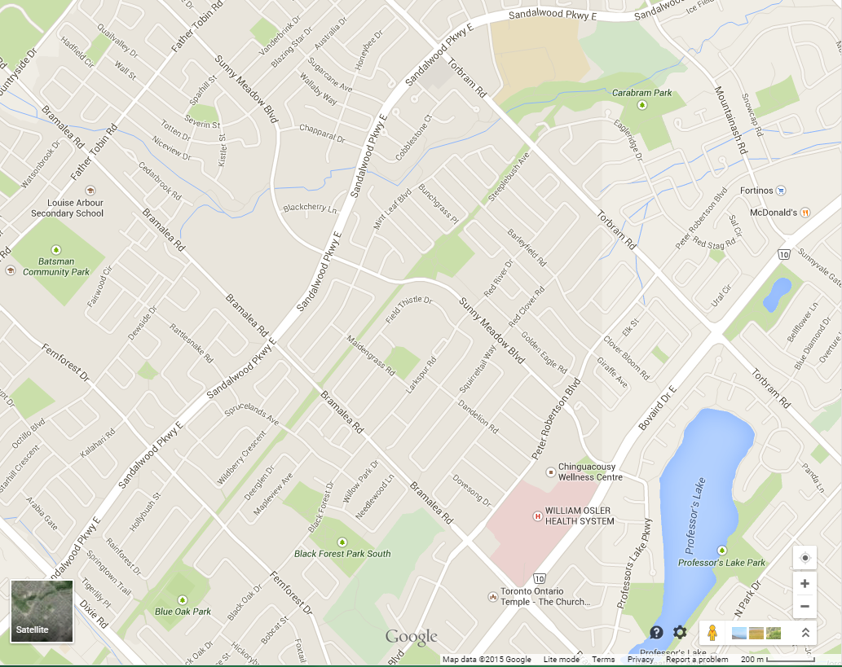
Map
Scale

Slide 4
Scale
?? = 200 m
1.0 cm = 154 m

Slide 5
A Story in Motion
After school, you and your friends went to the McDonalds at the Fortinos Plaza on Bovaird.
Trace your path on the map.
Calculate your distance travelled (using the scale on the map.)
How far did you go?

Slide 6
2.6 Km
2.1 Km
Map
Scale

Slide 7
3.3 Km
2.6 Km
2.1 Km
Map
Scale

Slide 8
Vectors & Scalars
Scalars (Distance is a scalar)
Have just a number (no direction, no arrow)
= 4.7 Km
Vectors (Displacement is a Vector)
Have both a number (magnitude) and a direction
The arrow indicates a vector
= 3.3 Km [East]
Δd
Δd

Slide 9
Distance vs. Displacement
Distance:
The total length of the path taken to move from one position to another position, regardless of direction.
The symbol for distance is:
Displacement:
The net change in position, regardless of the path taken.
Displacement has both a length and a direction.
The symbol for displacement is:
Δd
Δd

Slide 10
I live 1Km from school
?

Slide 11
Vector or Scalar
Which of the following are vectors?
50 m [North]
120 Km
22 cm [Up]
3.3 mm
-5 m [Left]
Can the following measurements ever be vectors?
45 Seconds
2.5 Liters
10 Kilograms

Slide 12
Δ – A Symbol for Change
Displacement is the change in position…
Where:
is the Initial position
is the Final position
Δd
=
d_{f}
̶
d_{i}
d_{i}
d_{f}

Slide 13
Position ( d )
A specific point in space relative to a chosen reference point.
(x, y) relative to origin
10 m [North] relative to a landmark
A position must include
A distance from the reference point
A direction from the reference point

Slide 14
Back To Our Map
Assume
Bramalea Rd. runs North / South
Bovaird Dr. runs East / West
Corner of Bovaird & Bramalea is our point of reference
What is the position of LASS?
Initial position
What is the position of McDonalds?
Final position

Slide 15
2.6 Km [North]
2.1 Km [East]
North
East
Map
Scale
Reference
Point

Slide 16
d – Position
d_{i}
Louise Arbour: = 2.5 Km [North]
McDonald’s: = 2.0 Km [East]
d_{f}

Slide 17
d – Position
d_{i}
Louise Arbour: = 2.5 Km [North]
McDonald’s: = 2.0 Km [East]
So What Is The Displacement?
d_{f}

Slide 18
2.5 Km [North]
3.2 Km [South East]
2.0 Km [East]
North
East
Map
Scale
Reference
Point

Slide 19
Displacement Example (1D)
Initial position = 5 m [East]
Final position = 25 m [East]
What is the displacement?
Δd
=
d_{f}
̶
d_{i}

Slide 20
Displacement Example (1D)
Initial position = 5 m [East]
Final position = 25 m [East]
What is the displacement?
Solution:
Δd
=
d_{f}
̶
d_{i}
d_{i} = 5 m [E]
Δd
=
25m [E] – 5m [E]
d_{f} = 25 m [E]
Δd
=
20m [E]

Slide 21
Directions
Directions come in pairs
Left / Right
Up / Down
North / South
East / West
Conventions:
Pick one direction to be positive (it doesn’t matter which one)
The other direction is then negative
e.g. 55 m [Left] = -55m [Right]

Slide 22
Displacement Example (2)
Initial position = 5 m [East]
Final position = 25 m [West]
What is the displacement?

Slide 23
Practice – Find the Displacement
Initial Position = 25 m [Up], Final Position = 35 m [Down]
Initial Position = 60 Km [East], Final Position = 60 Km [West]
Initial Position = 20 Km [North], Final Position = 0 Km [South]
Initial Position = 30 cm [Up], Final Position = 40 cm [Left]

Slide 24

Speed
Speed formula:
Note: Speed is a scalar
If it took you 30 minutes to get to McDonalds what was your speed?
$$v= \frac{Δd}{Δt}$$

Slide 25
2.5 Km
2.0 Km
Map
Scale

Slide 26
Velocity
Velocity formula:
Note: Velocity is a vector
If it took you 30 minutes to get to McDonalds what was your velocity?
$$v= \frac{Δd}{Δt}$$

Slide 27
3.2 Km
2.5 Km
2.0 Km
Map
Scale

Slide 28
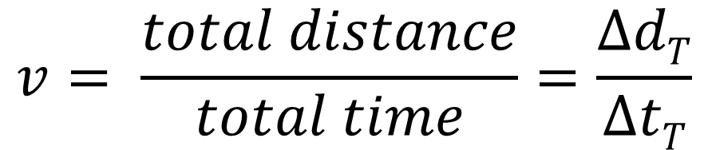
Average Speed
Average Speed Formula:
The speed limit on Bramalea and Bovaird is 60 km/h but there are several stop lights. How does this affect your average speed?
$$v= \frac{total distance}{total time}=\frac{ΔdT}{ΔtT}$$

Slide 29

Average Speed
Average Speed Formula:
The speed limit on Bramalea and Bovaird is 60 km/h but there are several stop lights. How does this affect your average speed?
$$v= \frac{total distance}{total time}=\frac{ΔdT}{ΔtT}$$
$$v= \frac{Δd}{Δt}$$
Is your speed for parts of the trip

